Slide 1

INTRODUCTION TO WIRELESS SENSOR NETWORKS
CHAPTER 1: WHAT ARE WIRELESS SENSOR NETWORKS?
Anna Förster

Slide 2
OVERVIEW
Wireless Sensor Networks
Sample Applications Around the World
Types of Wireless Sensor Networks

Slide 3
TYPICAL WIRELESS SENSOR NETWORK

Slide 4
WIRELESS SENSOR NETWORK
The resources of individual nodes are highly limited
Wireless links are spontaneous and not planned
The network senses some phenomenon and needs to transfer the data to an external user
The main functionalities of a sensor node are sensing and sending

Slide 5
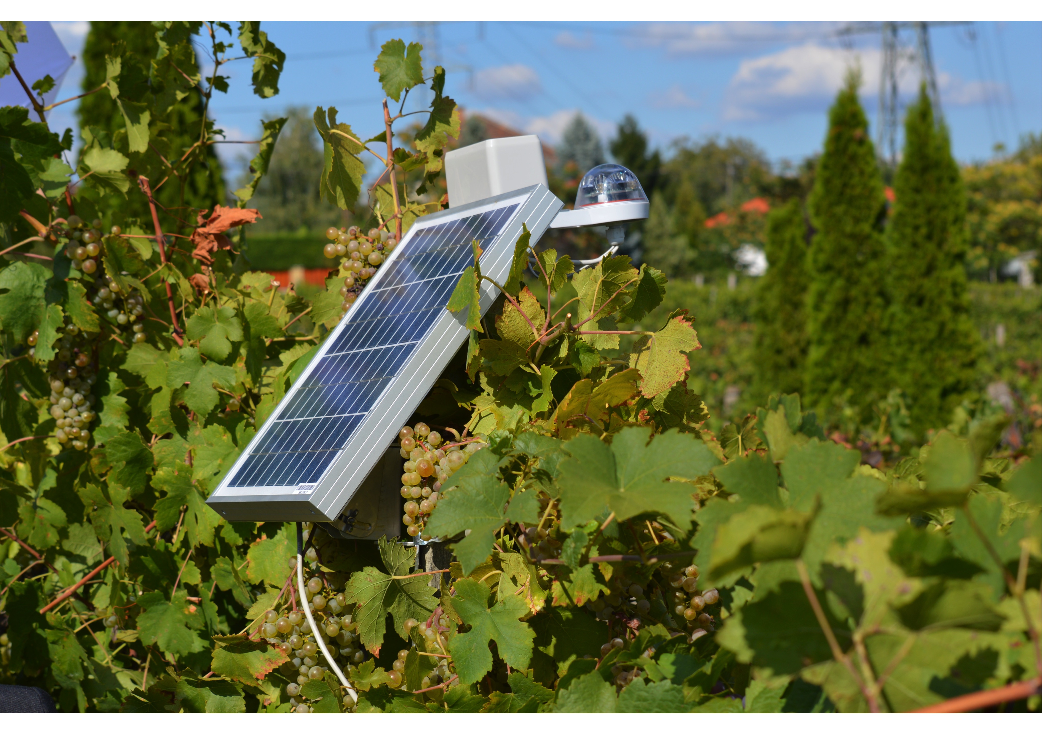
SAMPLE APPLICATION (1)
Vineyard monitoring (SmartVineyard Solutions, Hungary)

Slide 6

SAMPLE APPLICATION (2)
Bridge Monitoring (Charilaos Trikoupis, Greece)
Guillaume Piolle, Flickr

Slide 7
SAMPLE APPLICATION (3)
Animal Monitoring and Virtual Fences (CSIRO, Australia)

Slide 8
TYPES OF SENSOR NETWORKS
Wireless Sensor Networks
Cyber Physical Systems
Body Sensor Networks
Internet of Things
Participatory Sensing
Collaborative Sensing
Crowdsourcing

Slide 9
SUMMARY
Sensor networks consist of few to thousands of nodes
Nodes are low-cost and small-size
Sensor network design is tightly coupled to the application it serves
Main challenges:
Sensing
Communication
Energy-efficiency
Installation

